Slide 1
Intermediate Assignment Python
NOR YANA – FSDA
Link to collab
https://colab.research.google.com/drive/1jrd6ZNzcvYHwhfYMTqmTQctCPhVpOEeQ#scrollTo=LmZpwoU9nGkE

Slide 2
Analytical Objective
Our objective is to analyze promotion program's performance, identify different user segment and discover business opportunities for RevoBank in the future so they can maximize the use of promotion cost.

Slide 3
Data Cleaning
Change the type of the data from int64 to str for: MOB, HOMEOWNER_STATUS, FLAG_FEMALE, PROMO_CHANNEL
Change birth date from str type of data to datetime64
Remove one outlier which is 5311-Department Store
Remove toktoklive and El Corte Ingles
Removing -1 in AVG_TXN_AMT_LTM
Checking duplicates data

Slide 4
Data Cleaning
There is No Null Data
There is No Duplicate Data
FINAL DATASET :
From 112634 Data to 111133

Slide 5
Exploratory Data Analysis
Descriptive Statistics
How many Revoshop customers?
Count the ACCOUNT_ID = 111133 customer
2. What are the customer demographic? Grouping customer’s age, MOB and gender
Customer’s age
Gen X = 58.076 customer, Millenials = 52.671 customer, Boomers = 282 customer, Gen Z= 104 customer
MOB
The Average MOB is on 0 – 200
Gender
Female= 64996 (59%) while male= 46137 (41%)

Slide 6
Exploratory Data Analysis
Descriptive Statistics
3. How many sales were made in the response to promo in the last 6 months?
Average promo sales amount in 6 months * Number of promo transactions in 6 months= 35.205.412
4. what percentage of total sales is attributed to the promo?
Total Promo sales in 6 months * Number of transaction in 6 months = 60.6%
Which means,
39.4% of sales were not contributed to promo
22.872.435 are sales NOT contributed with promo

Slide 7
Exploratory Data Analysis
Descriptive Statistics
5. what is Average number of transaction in their life time and over past 6 months?
Total transaction in 6 months * total customer = 4.47
Total transaction lifetime * total customer = 20.09
6. what is the total cost of promotion over past 6 months?
Number of transaction in 6 months * 1.5 = 461.355

Slide 8
Exploratory Data Analysis
Descriptive Statistics
7. What is the revenue generated in the last 6 months?
Total promo transation amount * 2.4 = 844.929.91
8. How many customer considered promo sensitive?
75932 = 68.3%

Slide 9
END OF MILESTONE 1 INTERMEDIATE

Slide 10
Method and Variables Used for Clustering
Variables Used :
TOTAL_TXN_AMT_L6M = Total transaction sales in 6 months
TXN_CNT_L6M = number of transaction in 6 months
Because we want to see spending pattern of customer after Revobank implying the 6 months promo agenda for Revoshop customer

Slide 11
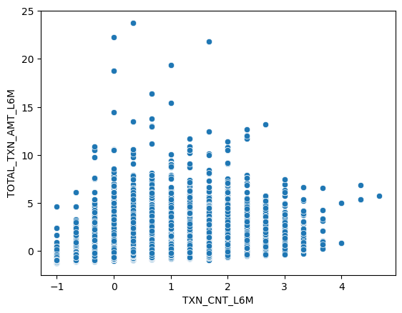
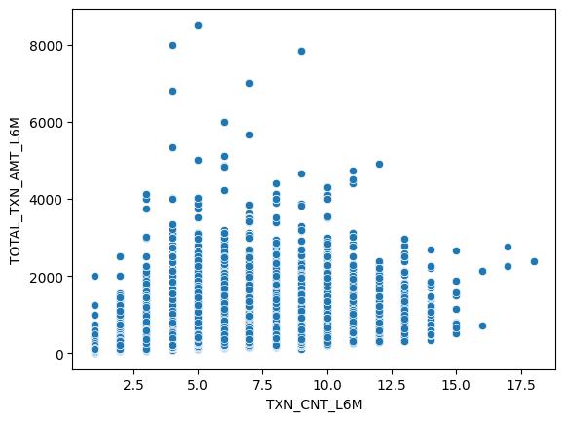
Data Distribution
Standard scaler
Robust Scaler

Slide 12
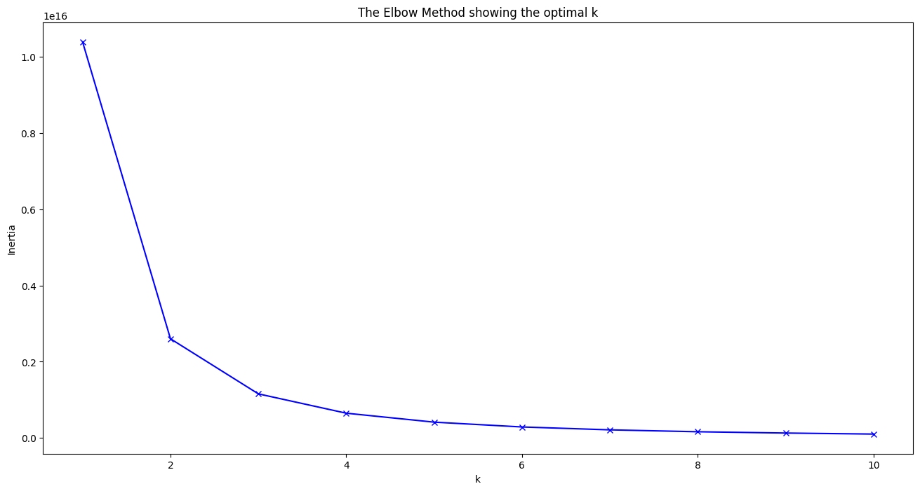

Method and Variables Used for Clustering
K-means suits numerical value
The best N-cluster= 3 cluster

Slide 13
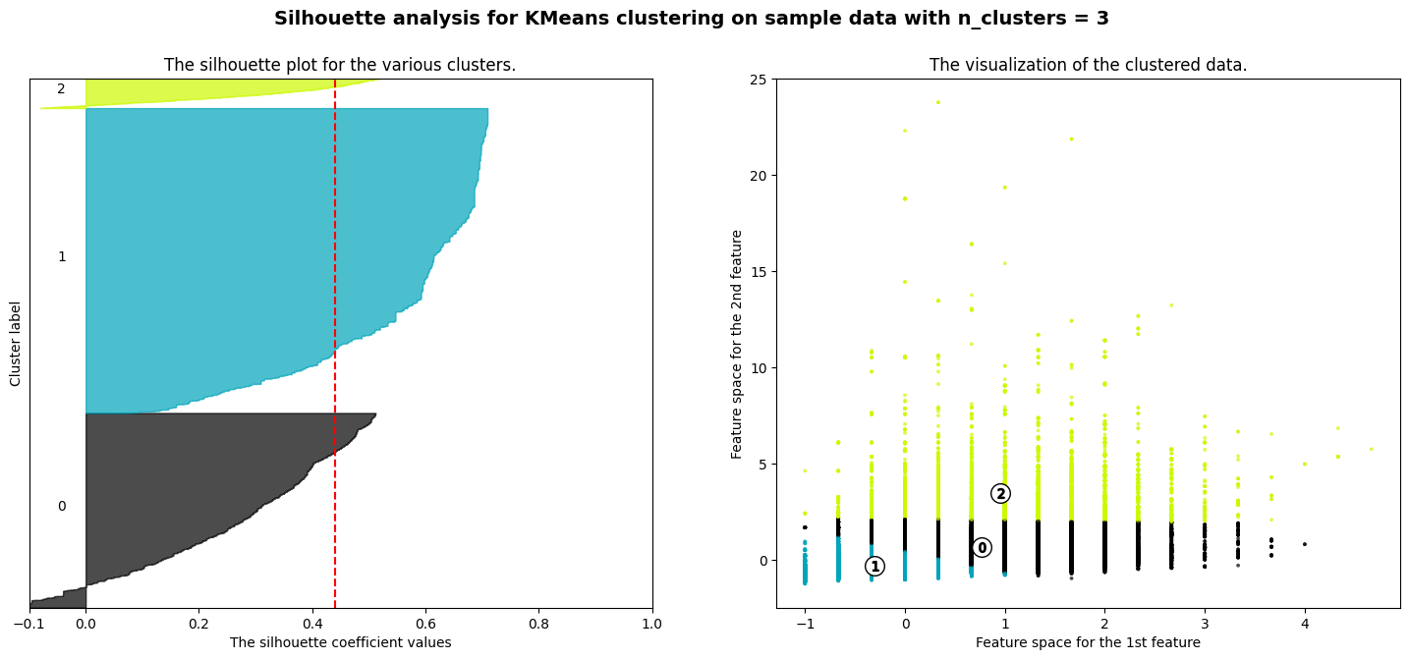
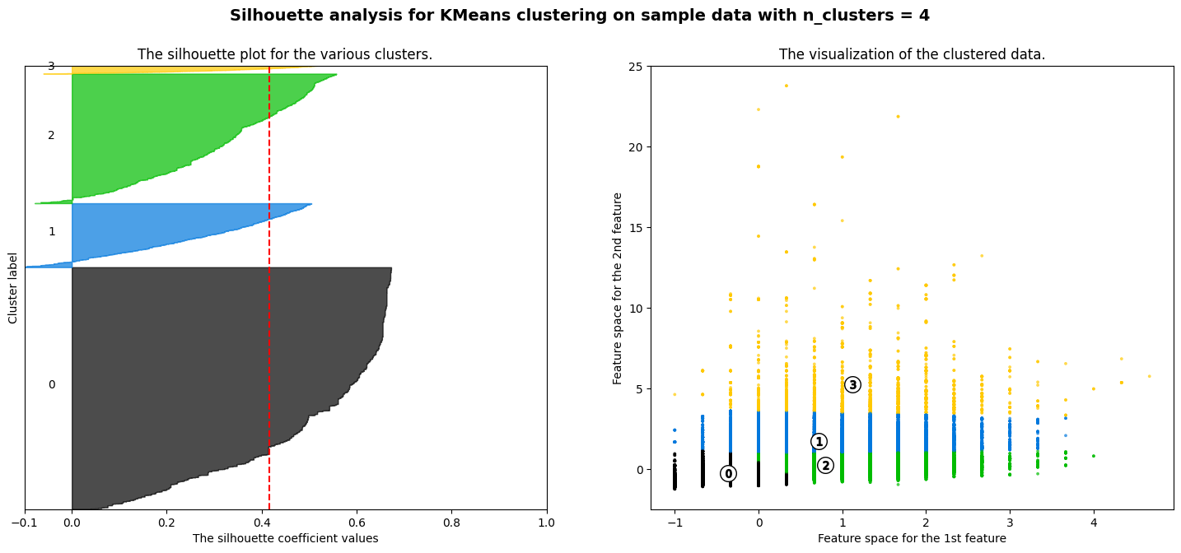
Silhouette Analysis
use robust scaler because I have not removed outliers
For n_clusters = 3 The average silhouette_score is : 0.4401563368599225
For n_clusters = 4 The average silhouette_score is : 0.4161335696025593
The silhouette score for 3 cluster is slightly higher

Slide 14
Interpreting Clustering
Promotion cost is 58.9% of their total revenue
Promotion cost is 27.8% of their total revenue
Promotion cost is 61.7% of their total revenue

Slide 15
Interpreting Clustering
Higher average sales = Cluster 1 = 1572
Higher average number of transaction = Cluster 1 = 7
Higher total revenue = Cluster 2 = 395.553
Higher Portion of Promo Sensitive Client Cluster 0 = 42.002
Promotion cost = cluster 1> cluster 0> cluster 2
Conclusion :
Promo sensitive clients didn’t give Revobank their highest revenue/ Promo sensitive customer doesn’t equal to revenue
The highest amount of sales and transaction has the least promo sensitive clients
Income and age didn’t have much influence to the sales
Cluster 1 with the lowest number of Promo sensitive customer succeed to bring Revobank their highest amount of sales, highest promo amount, highest transaction number and the lowest promotion cost

Slide 16
Insight
6 months promotion program's performance in Revobank is not effective
Promotion cost can be cut down or change to a new method/approach

